Slide 1

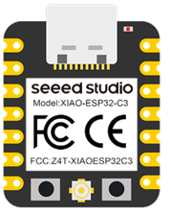
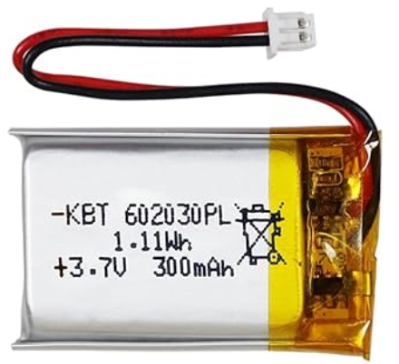
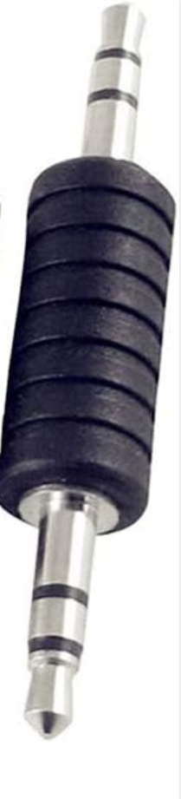
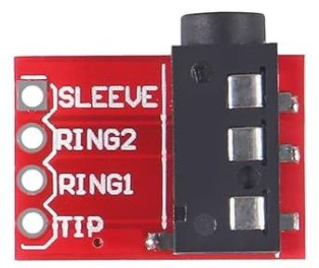

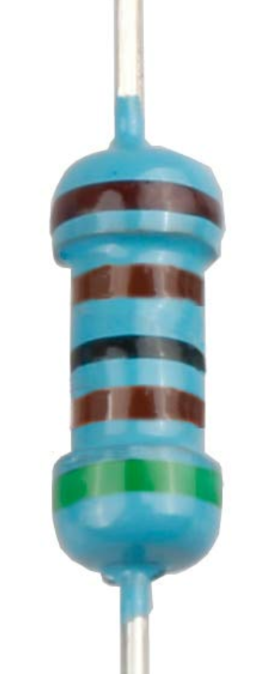
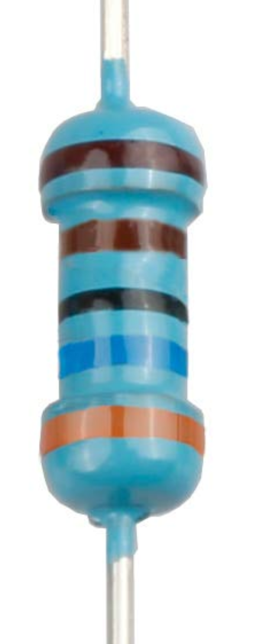
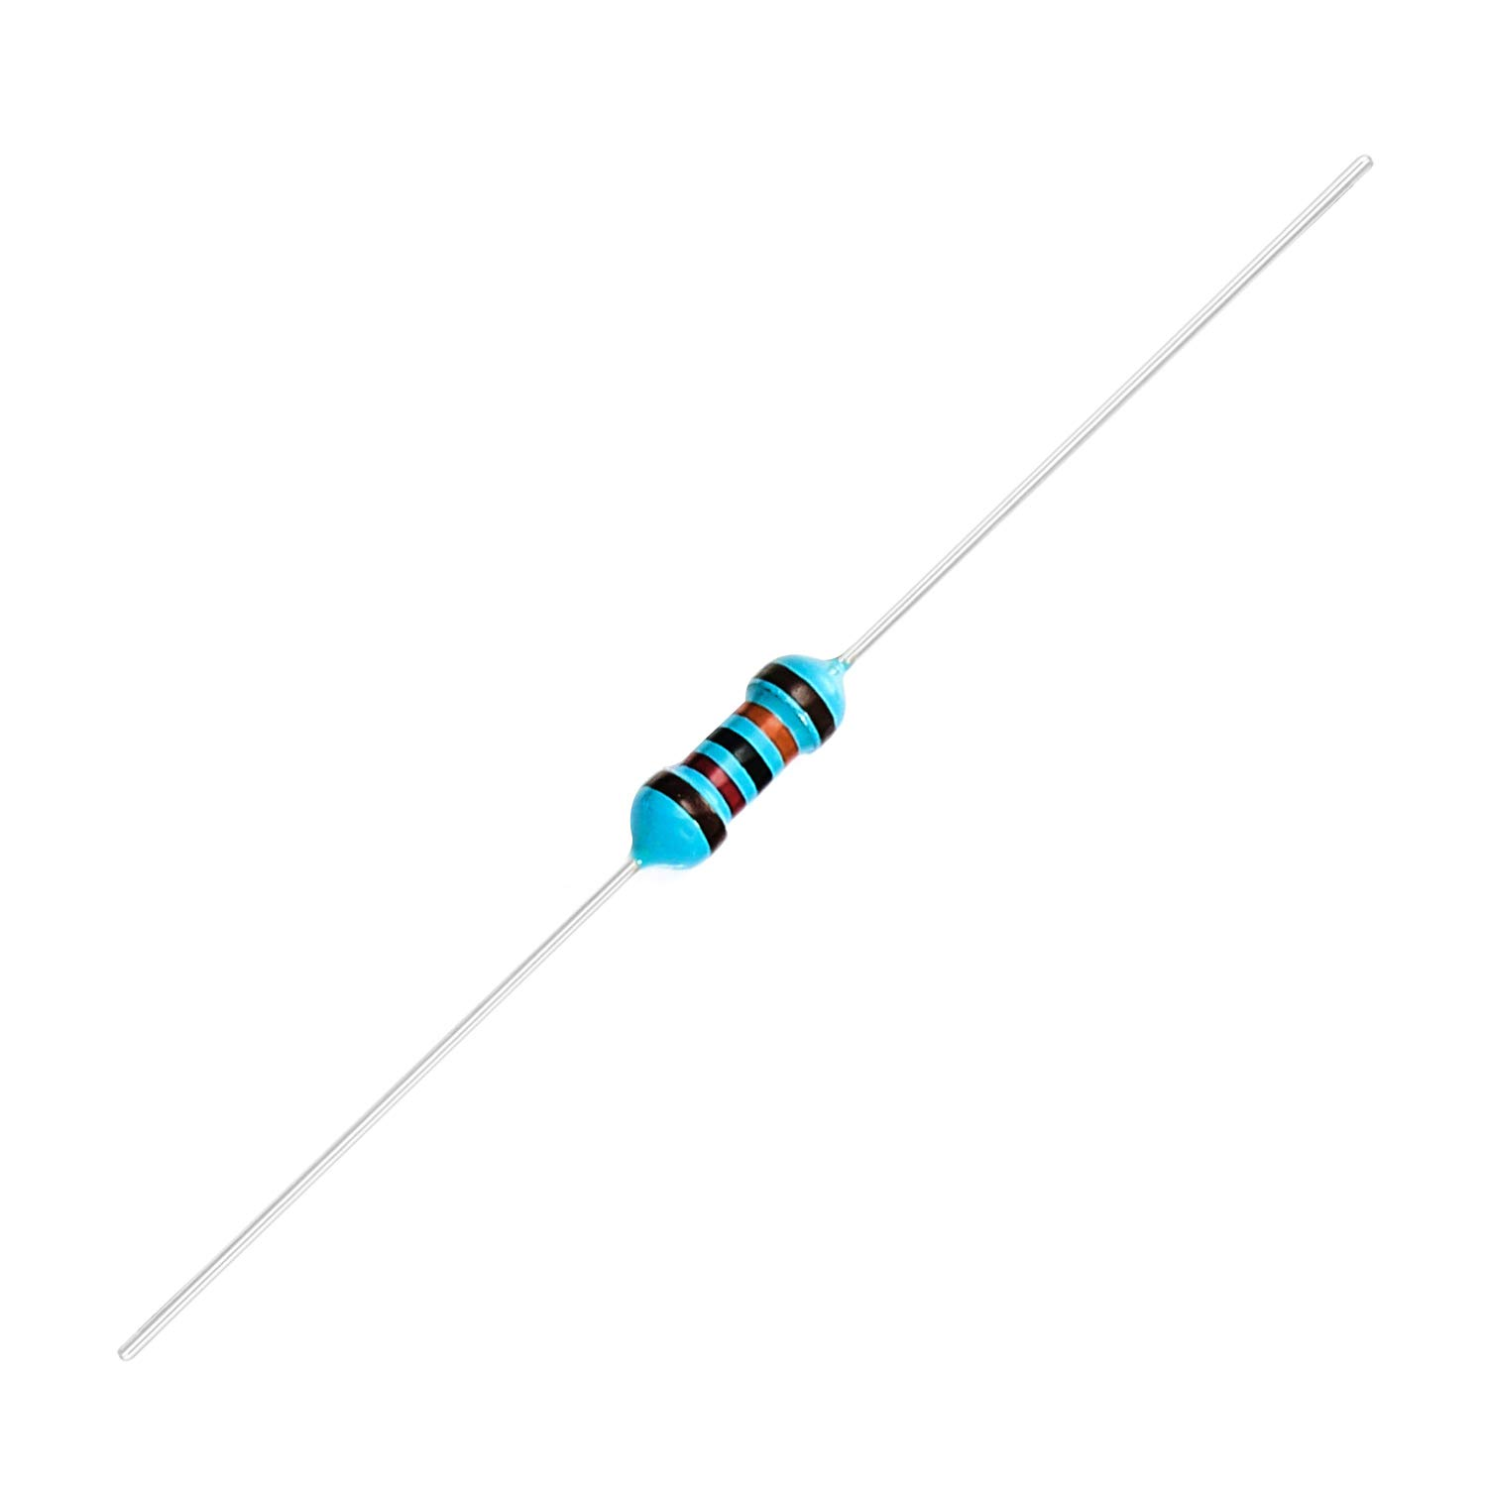
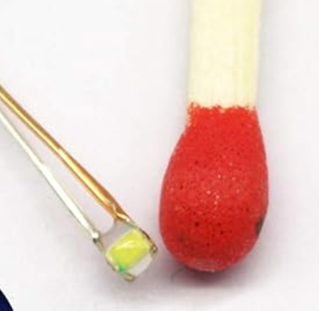
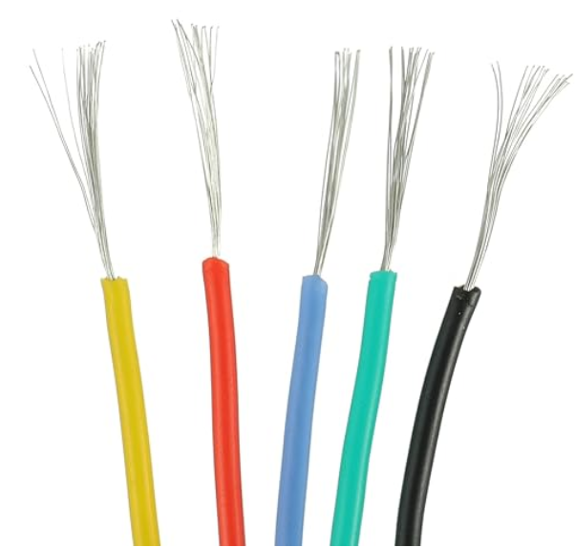
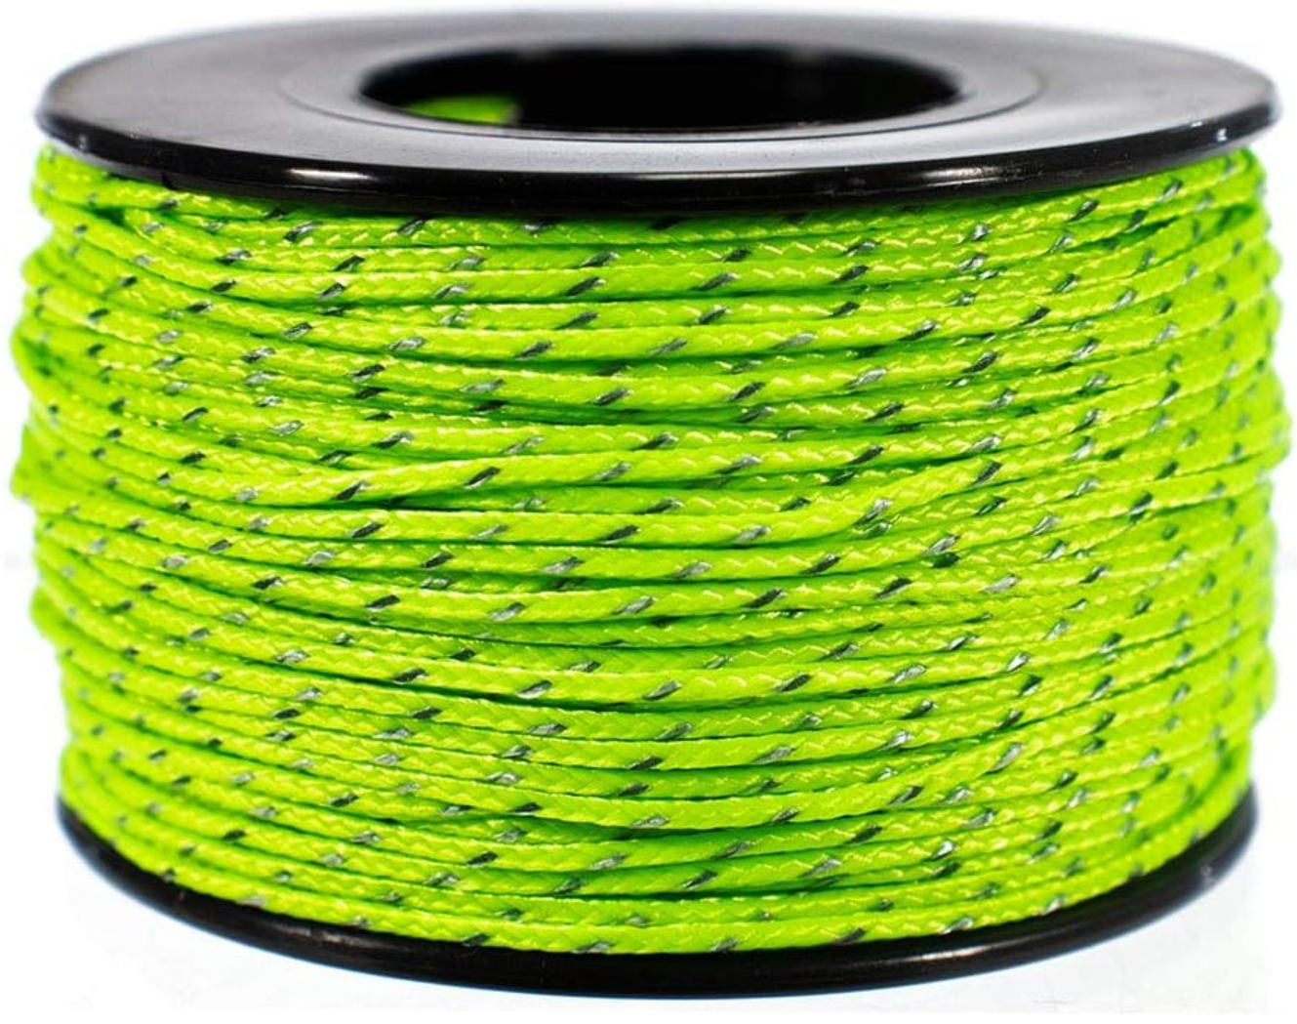


SOTACAT
COMPONENT | QUANTITY | IMAGE | NOTES
Seeed Studio XIAO ESP32C3 | 1 |  | Package includes an external and foldable WiFi antenna.
3.7 volt LiPo 300mAh Recharagble Battery 602030 | 1 |  | The only UL listed battery I’ve found for this size is from EEMB. Other manufacturers are much cheaper.
3.5mm-to-3.5mm Male-to-Male TRS Plug | 1 |  | Must be TRS and not TRRS!
3.5mm TRRS Jack board | 1 |  | Must be TRRS and not TRS!
1” diameter and 0.188” diameter Shrink Tubing | 2 |  | In V2 of the kit there is a 3rd shrink tubing for the leash & 3.5mm TRS
5.1K Ohm Resistor | 1
3.6K Ohm Resistor | 1
120K Ohm Resistors | 2 |  | Must be 1% tolerance or better.
1 Red and 1 Blue LEDs | 2 |  | Special 20mA LEDs don’t need resistor, and have insulated leads.
1 Red, 1 Black, 1 Green wires (28 AWG) | 3
1.18mm braided reflective cord | 6 inch |  | Tether for the TRS-to-TRS
Rubbermaid Mat | 3cmx2cm |  | The stuff you line kitchen drawers with.
UN3481 Shipping Label | 1 |  | Due to LiPo battery
9x6x2” Box | 1 |  | Meets USPS LiPo requirements
Bill of Materials
SOTACAT is a hardware module you can build that allows your mobile device to wirelessly control your transceiver using its “CAT” (Computer Aided Transceiver) port (also known as an “ACC” or “accessory” serial data port).
SOTACAT is currently designed to work with Elecraft KX2 and KX3 transceivers.
The SOTAMĀT app on your mobile device knows how to communicate with SOTACAT to automate functions such as sending SOTA and POTA spots, alerts, or sending pre-defined messages (SMS/eMail).
When used to self-spot with SOTAMĀT, the SOTACAT module controls the Elecraft radio so that it directly synthesizes FT8 messages over-the-air without using audio (direct FSK synthesis, without using the microphone jack or the built-in microphone).
SOTAMĀT skimmers (automated monitoring stations) receive your transmission and decode the special SOTAMĀT FT8 messages. The SOTAMĀT server then executes your command (spot, alert, message, etc.).
CW SOTA operators can use SOTACAT and SOTAMĀT’s “Alert-CW” mode to tickle the RBNhole service to automatically start spotting you as you QSY on CW. That means you don’t have to remember to post a SOTA Alert before your trip: you can self-alert for RBNhole on the summit!
Before using SOTACAT, you should first learn how to use SOTAMĀT. You must first create an online configuration before you can use SOTAMĀT. Full instructions are found at: https://sotamat.com and search for an assembly video on YouTube.
The QR code on page 3 links to a YouTube assembly instructions video.
Attribution: concept by AB6D with contributors KI6SYD and Elecraft Inc.
Original hardware concept by AB6D.
2024-02-17 V2.25

Slide 2
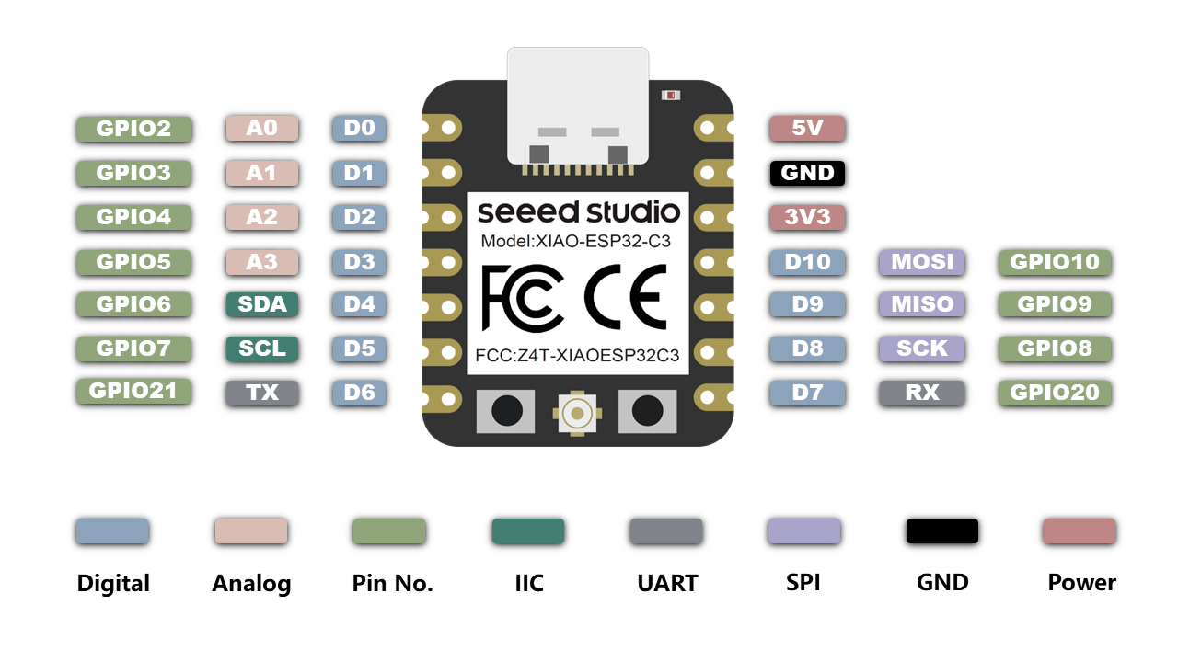
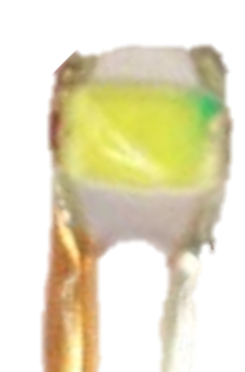
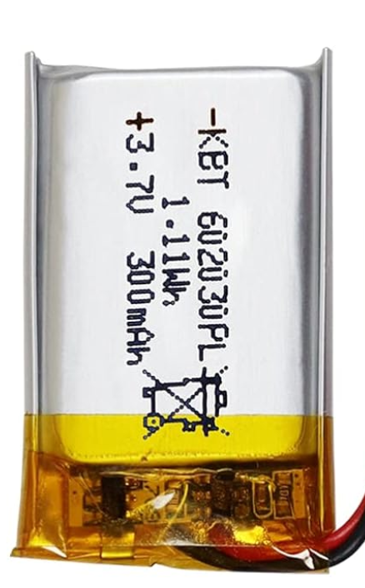

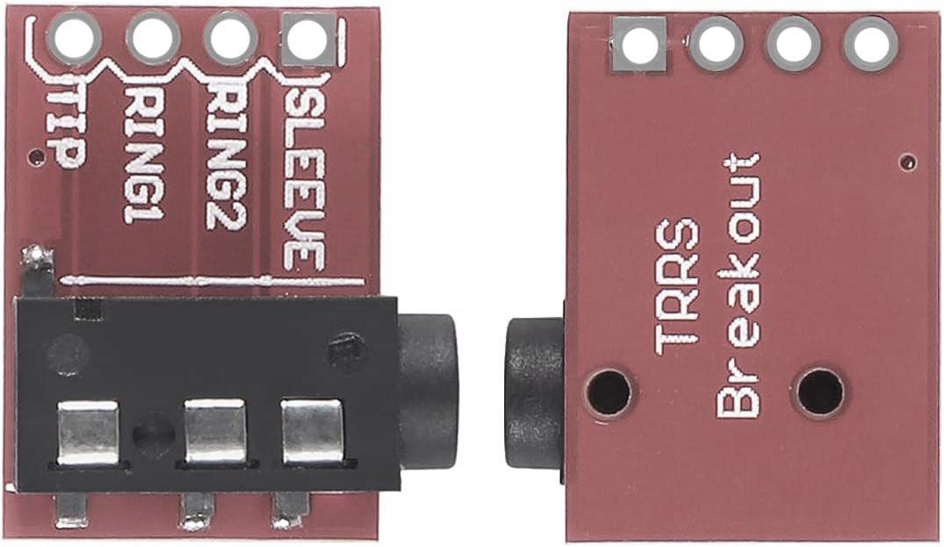
SOTACAT
Video instructions: https://youtu.be/iD3S-9icRn0
FLIP
Red
Blue
F
Assembly instructions
120K
G
120K
E
Start by attaching the WiFi antenna to the jack on the ESP32C3 WiFi module. It is delicate but requires some force. Try grabbing a lip and rotating into place. Route the coax downward.
*
C
A
Solder one end of red wire on back of board to the BAT+ terminal
M
D
B
Solder one end of green wire to the D6 hole (on top)
H
Position Blue LED and measure length of silver lead needed to hole D10 and trim lead. Use sandpaper to carefully remove just enough insulation for the very tip of the lead wire where the solder joint will be. Do not remove more insulation than the tip because any extra exposed uninsulated wire can cause a short.
B
C
5.1K
A
3.6K
I
D
Do the same (measure, trim, sandpaper tip) for the gold/orange lead of the Blue LED. Solder into hole “3V3”.
J
E
Repeat step “C” and “D” but for the Red LED: solder the Red LED silver lead into hole D8 and the gold/orange lead into hole D9.
K
L
F
Solder one end of both of the 120K resistors together into hole A0/D0. Sometimes both leads will fit in the hole, other times only one will fit and the other must be twisted and soldered to the other after going thru the hole.
120K
120K
O
G
Place both one end of the Black wire and a remaining free end of one of the 120K resistors into the GND hole. Solder them together into GND. If they don’t both fit, have one go thru the hole, twist and solder the other to it.
N
120K
H
Solder together in hole D7: one end of the 3.6K resistor and one end of the 5.1K resistor. These often both fit in the hole, but if not, have one go through the hole and have the other twist to it and solder together.
5.1K
3.6K
Route, measure, trim, and solder together the following 3 items: the remaining end of the remaining 120K resistor, the remaining end of the Red wire connected to the BAT+ terminal on the back of the board, and the Red wire from the Battery.
Re-trim solder joint if needed, and cover with small insulation shrink tubing to prevent shorts (use heat gun or flame to shrink tubing around exposed wires).
M
I
Route, measure, trim, strip, and solder the remaining end of the Green wire into hole “TIP” on the jack board.
J
5.1K
Solder the remaining end of the 5.1K resistor into hole “RING1”
Fold the battery under the board. Trim any sharp solder joints to protect battery from puncture. Place rubber protection pad between battery and board. Hot glue the reflective leash cord to the side of the assembly.
Don’t overheat battery with glue. Hot glue (or epoxy) the other end of the leash cord to the 3.5mm Male-to-Male plug. Better yet: use shrink tubing (not supplied until V2 of the kit) around the 3.5mm adapter and leash.
N
O
K
3.6K
Combine and solder both the remaining end of the Black wire, and the remaining end of the 3.6K resistor into hole “RING2”
*
Wrap the flexible WiFi antenna around the assembly and route the coax out of the way. Enclose the entire assembly in the 1” diameter shrink wrap tube for protection and use heat gun (or flame) to shrink tubing around it.
L
Orient the battery, route, measure, trim, and solder the black wire from the battery into hole “SLEEVE”.

Slide 3
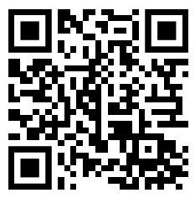
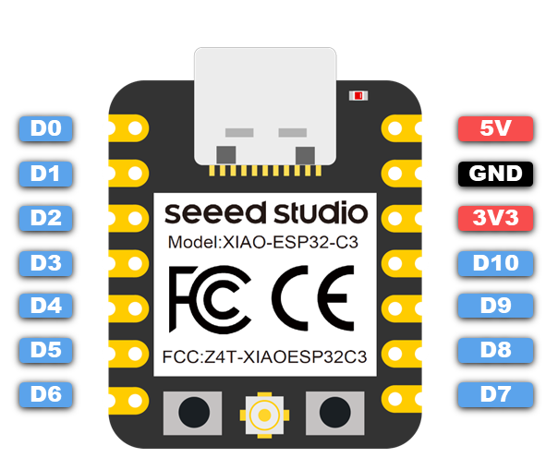
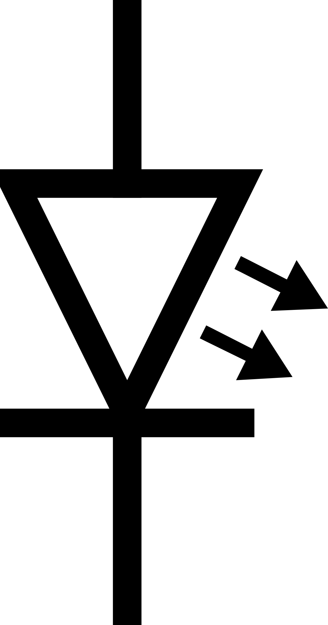
SOTACAT
Video instructions:
FLIP
Schematic
Battery monitor
voltage sense:
divide 4.4V max
source in half for ADC (< 2.2V)
120K
120K
5.1K
KX Tx → ESP UART Rx voltage divider
(reduce 12.5 v or less to 3.3v or less)
3.6K
Ring2 and Sleeve are shorted when the TRS-to-TRS plug is inserted. This is the power switch.
The special LED’s spec’ed don’t need current limiting resistors at 3.3v. If you substitute the spec’ed parts, add a resistor in series according to your LED’s needs.
Note: the LED’s are handled differently for ease of manual soldering. The Blue LED is connected to the 3.3V supply and one GPIO, while the Red LED is connected to two GPIO pins. Firmware corrects for this difference.

